Slide 1
Attention-Based Sentiment Analysis on Social Media
Zheyu YE
Supervised by Dr. Gopalan Anandha
September 10 2019
Presentation of MSc Individual Project

Slide 2
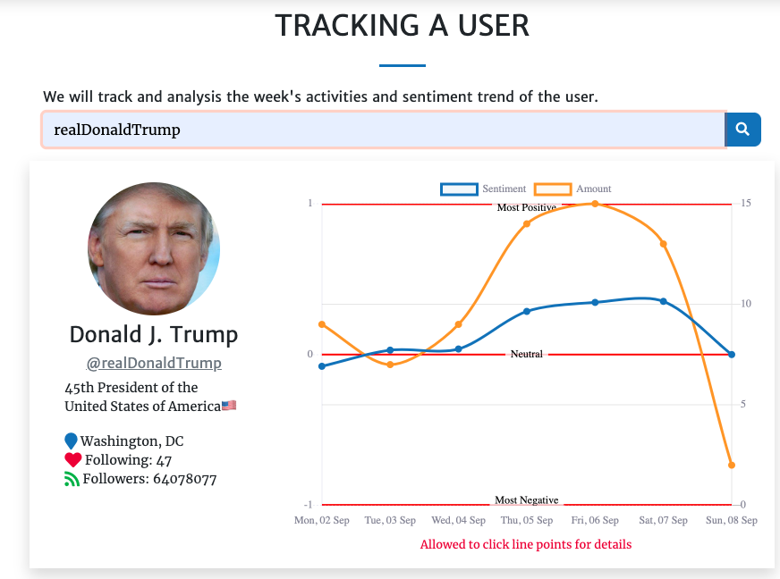
Content
2
Problem
Proposal
Data Collection
Experiments
Results
Conclusions
Test Before Tweet
(http://testbeforetweet.uksouth.cloudapp.azure.com/
or http://52.151.71.78)

Slide 3
Problem
3
What is our concern?
Feelings Convey
Consistent Understanding
Graphics expression (Emoji + Emoticons)
Emoji 💯
Emoticons :),:(
Public Relationship Tool
The Flood of Social Media

Slide 4
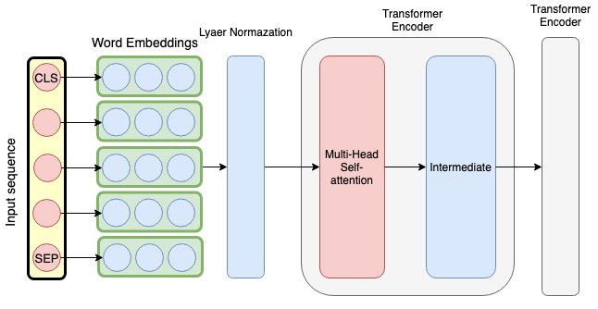
Proposal
4
Plain Text
Word Embedding
Based on ‘BERT’ [2]
Pre-trained + Fine-tuning
Attention Mechanism
Transformer Encoder [1]
Linear Classify and CNN Classify
Model Architecture

Slide 5
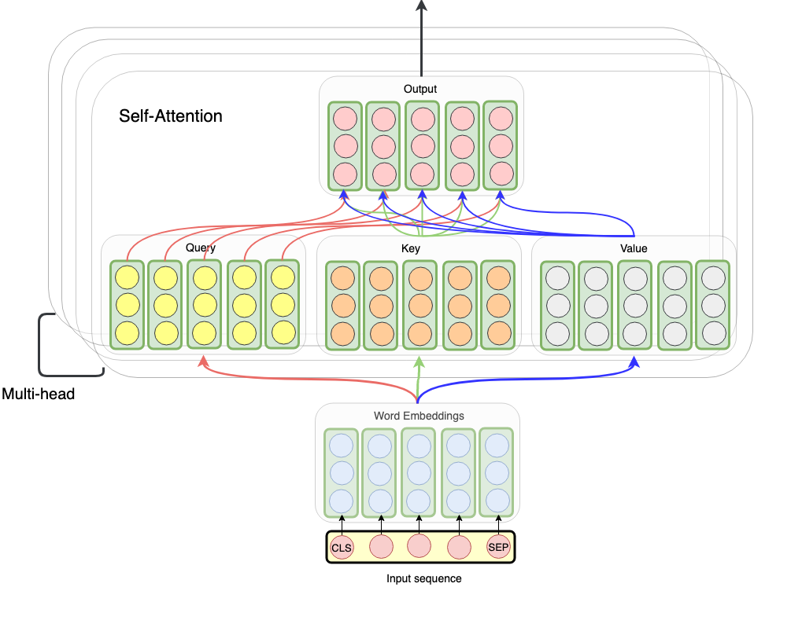
Self-Attention
3
5
Q,K,V are all matrix linearly transformers by input sequence
12 layers encoders
Layer Normalization [3]
Shortcut [4]

Slide 6
Emoji Attended Model
Emoji has its contextual meaning
Not just a graphics expression
e.g. “Today’s presentation made me crash 👏 👏 👏”
6

Slide 7
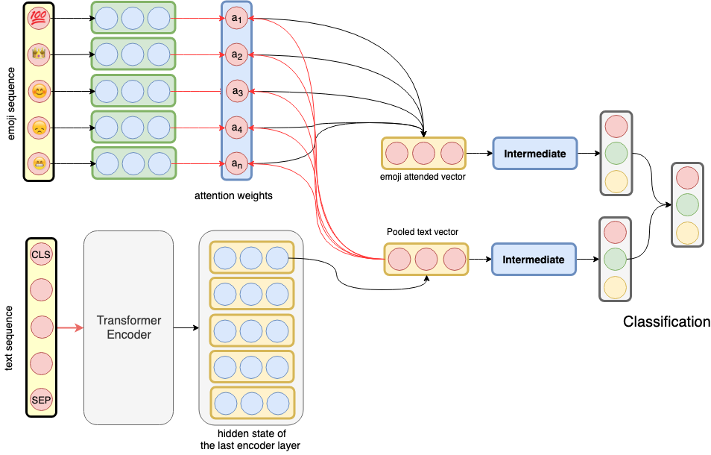
Emoji Attended Model
Ignores the position of Emoji
Use O-BERT for plain text
Contextual Attention between emoji and text
Different classifies
6

Slide 8
Classify
7
(O-BERT) Linear Classify use the hidden state of first token ‘[CLS]’
(CNN-BERT) CNN Classify used the all hidden states of the whole sequence instead of initial embedding as below
Get same performance
Text CNN [6]

Slide 9
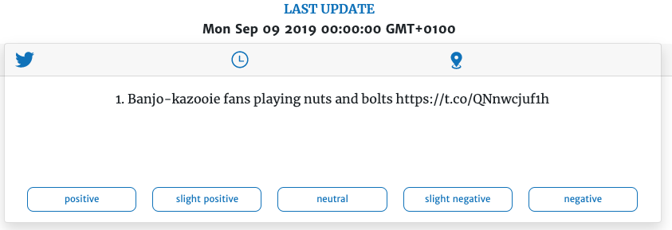
Data Collection and Annotation
Insufficient Data (Especially for Emoji)
Manual Annotation
Changing 5 classes to 3 classes
Split “slight” to adjacent option
2 months 337 samples
Used to test

Slide 10
Data Collection and Annotation
9
Insufficient Data (Especially for Emoji)
Manual Annotation (2 months 337 samples)
Automatic Annotation
VADER rule-based sentiment analysis tool
Sentiment score 0.8671 for below example
Filtering (110,659 from 187,600)
Called Ternary Emoji (3-emoji)

Slide 11
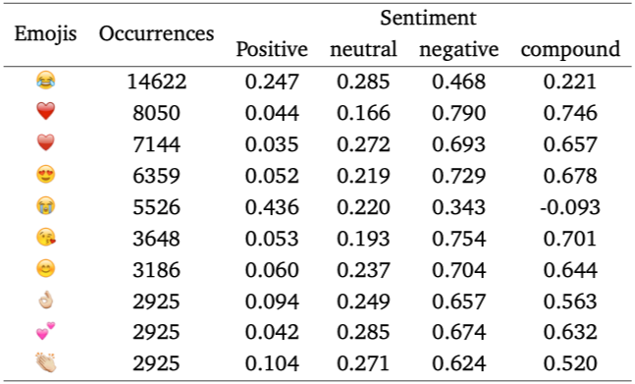
Emojis
10
Keep top 55 Emojis
Translate the rest to the text
e.g. 🏠 for ‘house’
Express more contextual meaning instead of emotional
Added to Embedding Vocabulary
avoiding to be identiﬁed as UNKOWN
Emoji Sentiment Ranking [5]
(http://kt.ijs.si/data/Emoji_sentiment_ranking/)

Slide 12
Emoticons
11
☺ Happy Emoticon :)
☹ Sad Emoticon :(
avoiding character segmentation like ‘:’ + ‘)’
Map to two Emoticons, then remove other characters
Mapping list for 72 emoticons

Slide 13
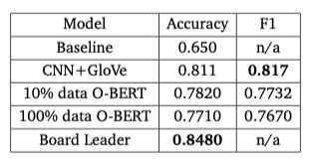
Experiments
12
Sentiment140 (plain text)
A dataset with 1.6M tweets
Got 78.20% accuracy
Hard to train, 8 hours for 1 epoch
Better results on only 10% data
Model performance on sentiment140

Slide 14
Experiments
13
Ternary Emoji (only consider plain text)
Similar result for linear classify and CNN classify
Frozen the features extractor (Transformer Encoders), only fine-tune the classify, got mediocre performance
Model performance on 3-emoji dataset

Slide 15
Experiments
14
Emoji Attended Model on Ternary Emoji
(using emoji as additional information)
No more improvement
The reason might be the text embedding is pre-trained on multiple large corpora, while the emoji embedding are random initialized
Create a dataset to feed the emoji, simulate its probability distribution in the real scene according to the emojis occurrences
Pre-training for emoji embedding

Slide 16
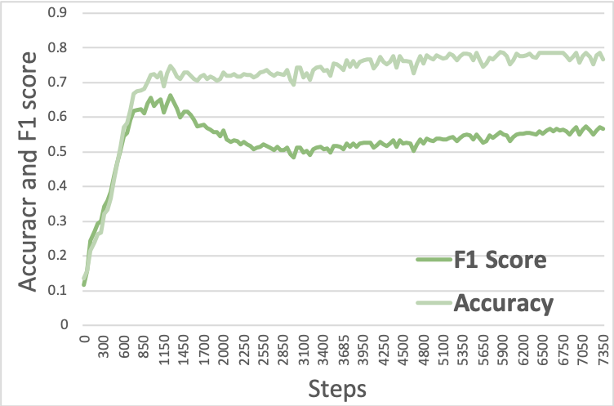
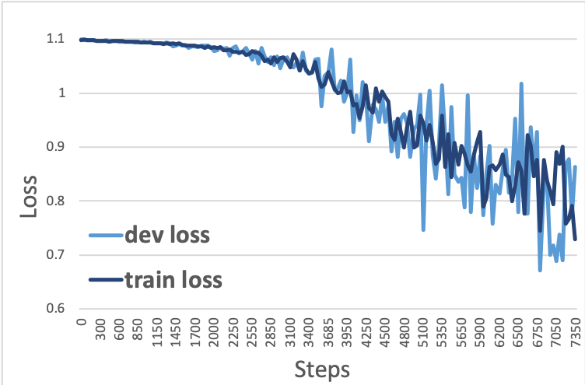
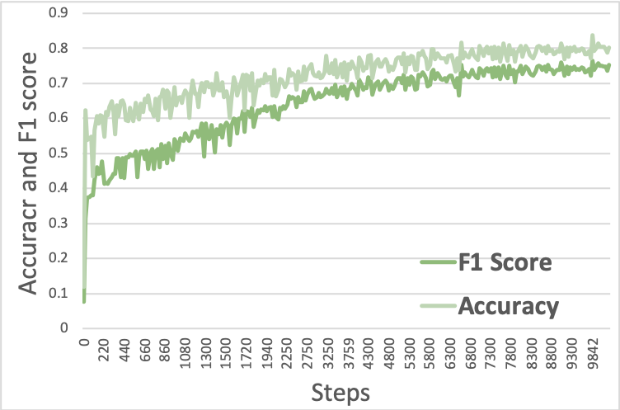
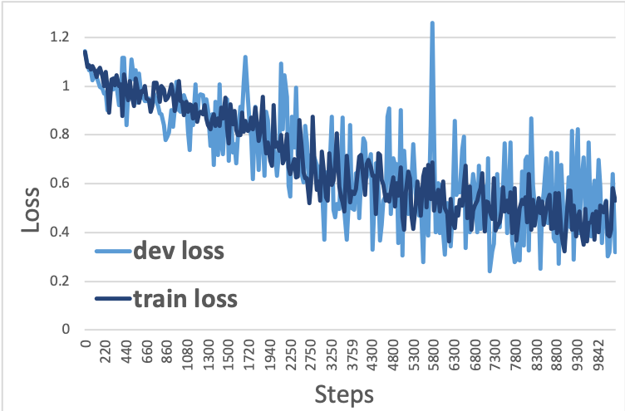
15
EA-BERT results
EA-BERT loss
FEA-BERT results
FEA-BERT loss

Slide 17
Training on Emoji-Feeded Dataset
16
After feeding
Got 6% improvement on test set
Deploy this model on our web application
Comparison of Emoji attended model and its feeding vision.

Slide 18
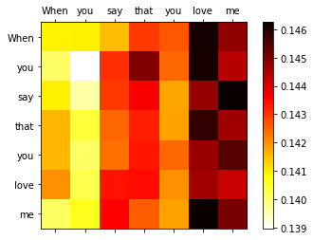
Attention Visualization
17
Attention Mechanism
Grab key information
Contextual Semantics
Tends to fail on “NOT”
Positive word “love”

Slide 19
Conclusion
18
Not good as exception
Cannot deal with negation i.e. “NOT”
Time and computational power constraints
Converge after 20 hours on 4 GPUs (1200 ponds a month)
Insufficient data
Lacking for emoji
Training data from automatic annotation instead of human

Slide 20
Reference
19
[1] Vaswani, A., Shazeer, N., Parmar, N., Uszkoreit, J., Jones, L., Gomez, A.N., Kaiser, Ł. and Polosukhin, I., 2017. Attention is all you need. In Advances in neural information processing systems (pp. 5998-6008).
[2] Devlin, J., Chang, M.W., Lee, K. and Toutanova, K., 2018. Bert: Pre-training of deep bidirectional transformers for language understanding. arXiv preprint arXiv:1810.04805.
[3] Ba, J.L., Kiros, J.R. and Hinton, G.E., 2016. Layer normalization. arXiv preprint arXiv:1607.06450.
[4] He, K., Zhang, X., Ren, S. and Sun, J., 2016. Deep residual learning for image recognition. In Proceedings of the IEEE conference on computer vision and pattern recognition (pp. 770-778).
[5] Novak, P.K., Smailović, J., Sluban, B. and Mozetič, I., 2015. Sentiment of emojis. PloS one, 10(12), p.e0144296.
[6] Kim, Y., 2014. Convolutional neural networks for sentence classification. arXiv preprint arXiv:1408.5882.

